Slide 1

Computer Organization and Assembly Language (CS2523)
Introduction to Assembly Language
Chapter 1 of
Assembly language for x88 processors, Belal Hashmi
Department of Computer Science,
Capital University of Science and Technology, Islamabad
Fall Semester, 2022

Slide 2
Lecture Outlines
Basic Computer Architecture
Registers
Instruction Groups
Intel iapx88 Architecture
iAPX (Intel Advanced Performance Architecture with X standing in for the Greek letter χ (chi), romanised as "ch") was a short lived designation used for several Intel microprocessors, including some 8086 family processors.

Slide 3
Lecture Outlines
History
Register Architecture
Our First Program
Segmented Memory Model

Slide 4
History
Basic Computer Architecture

Slide 5
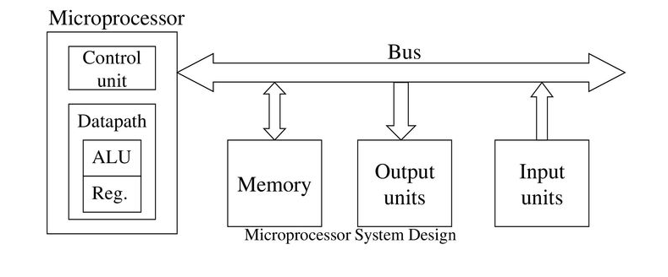
What are microprocessor-based systems?
Microprocessor-based systems are electrical systems consisting of microprocessors, memories, I/O units, other peripherals.
Microprocessors are the brains of the systems
Microprocessors access memories and other units through buses
The operations of microprocessors are controlled by instructions stored in memories

Slide 6
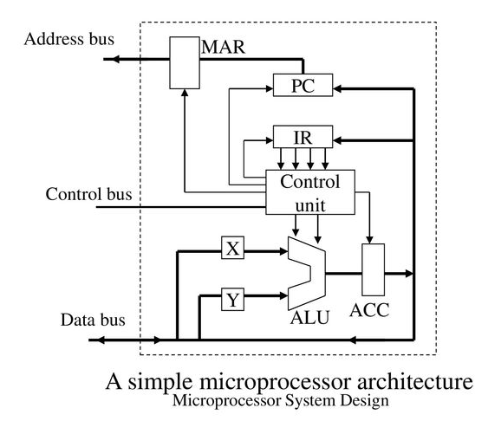
What are microprocessors?
A microprocessor is a processor (or Central Processing Unit, CPU) fabricated on a single integrated circuit.
MAR – Memory Address Register

Slide 7
Evolution of Computers
First Generation (1939-1954) – vacuum tube
Second Generation (1954-1959) – transistor
Third Generation (1959-1971) – IC
Fourth Generation (1971-present) – microprocessor
Microprocessor is an intelligent piece of integrated circuits. It forms the brain of circuits that require computing capability.
A microprocessor is an integrated circuit, but not all integrated circuits are microprocessors

Slide 8
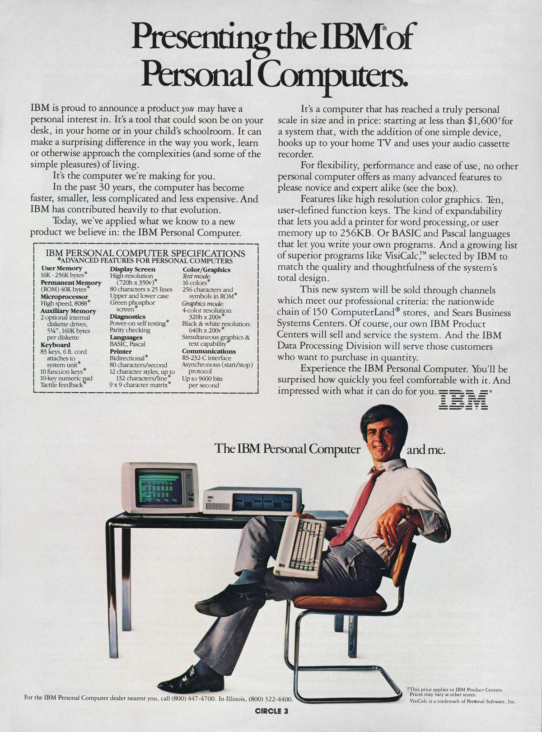
Hardware
Team from IBM building PC prototypes in 1979
8088 is 8-bit bus version of 8086 => allows cheaper system
Estimated sales of 250,000
[ Personal Computing Ad, 11/81]

Slide 9
Dimensions of Memory
Horizontal Dimensions = Width of Memory Cell
00000000
Vertical Dimensions
=
Size of
Memory
00000001
Binary
Addresses
Of
Memory
Cells
00100011
00100100
00100101

Slide 10
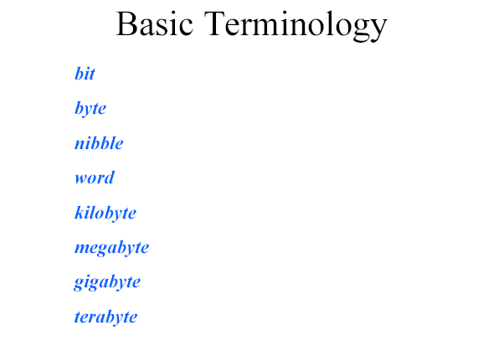

Slide 11
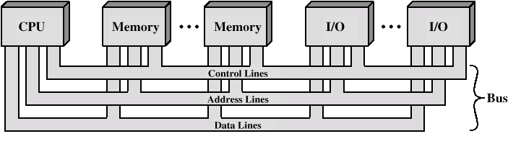
Bus Interconnection Scheme

Slide 12
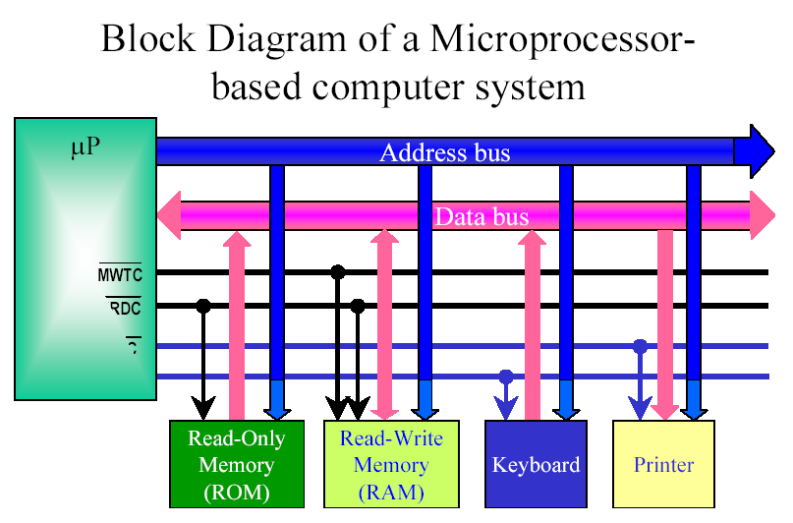

Slide 13
Some buzz words
...ha?
CISC – Complex Instruction Set Computers
Refers to number and complexity of instructions
Improvements was: Multiply and Divide
The number of instruction increased from
45 on 4004 to:
246 on 8085
20,000 on 8086 and 8088
RISC – Reduced Instruction Set Computer
Executes one instruction per clock
Newer RISC - Superscaler Technology
Execute more than one instruction per clock

Slide 14
Computer Organization
Computer Organization is concerned with the structure and behavior of a computer system as seen by the user.
It acts as the interface between hardware and software.
It deals with the components of a connection in a system.
Computer Architecture helps us to understand the functionalities of a system.

Slide 15
Buses
There are a number of possible interconnection systems
e.g. Control/Address/Data bus (PC)
What is a Bus?
A communication pathway connecting two or more devices
A number of channels in one bus
e.g. 32 bit data bus is 32 separate single bit channels

Slide 16
Computer Organization
Address bus - carries memory addresses from the processor to other components such as primary storage and input/output devices. The address bus is unidirectional.
Identify the source or destination of data e.g. CPU needs to read an instruction (data) from a given location in memory
Bus width determines maximum memory capacity of system e.g. 8080 has 16 bit address bus giving 64k address space

Slide 17
Computer Organization
Data bus - carries the data between the processor and other components. The data bus is bidirectional .
Carries data
Remember that there is no difference between “data” and “instruction” at this level
Width is a key determinant of performance
8, 16, 32, 64 bit

Slide 18
Computer Organization
Control bus - carries control signals from the processor to other components. The control bus also carries the clock's pulses. The control bus is bidirectional. For example to communicate from other devices to processor that other device is busy or having some issue to get data from the required address.
Control and timing information
Memory read/write signal
Interrupt request
Clock signals

Slide 19
Basic Computer Organization
Processor
Memory
I/O

Slide 20
Basic Computer Organization
Processor
Operation
Memory Data

Slide 21
Basic Computer Organization
Processor
Operation
Memory Data

Slide 22
Basic Computer Organization
Processor
Address Bus
Memory
Data Bus
Control Bus

Slide 23
Big and Yellow?
What do buses look like?
Parallel lines on circuit boards
Ribbon cables
Strip connectors on mother boards
e.g. PCI, Sets of wires
Peripheral Component Interconnect (PCI) is a local computer bus for attaching hardware devices in a computer and is part of the PCI Local Bus standard.

Slide 24
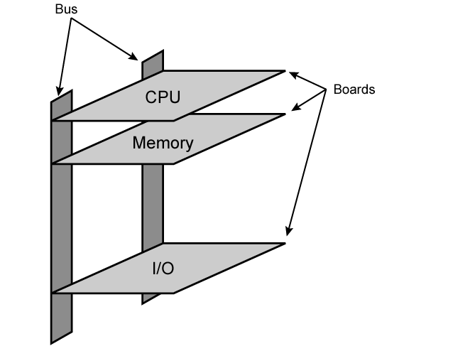
Physical Realization of Bus Architecture

Slide 25
Timing
Co-ordination of events on bus
Synchronous
Events determined by clock signals
Control Bus includes clock line
A single 1-0 is a bus cycle
All devices can read clock line
Usually sync on leading edge
Usually a single cycle for an event

Slide 26
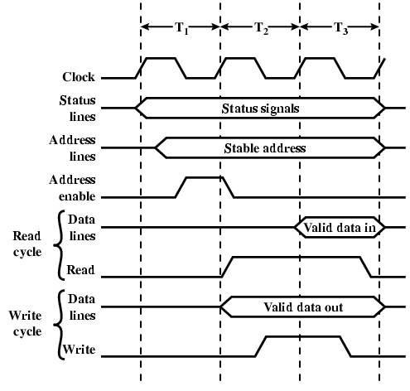
Synchronous Timing Diagram

Slide 27
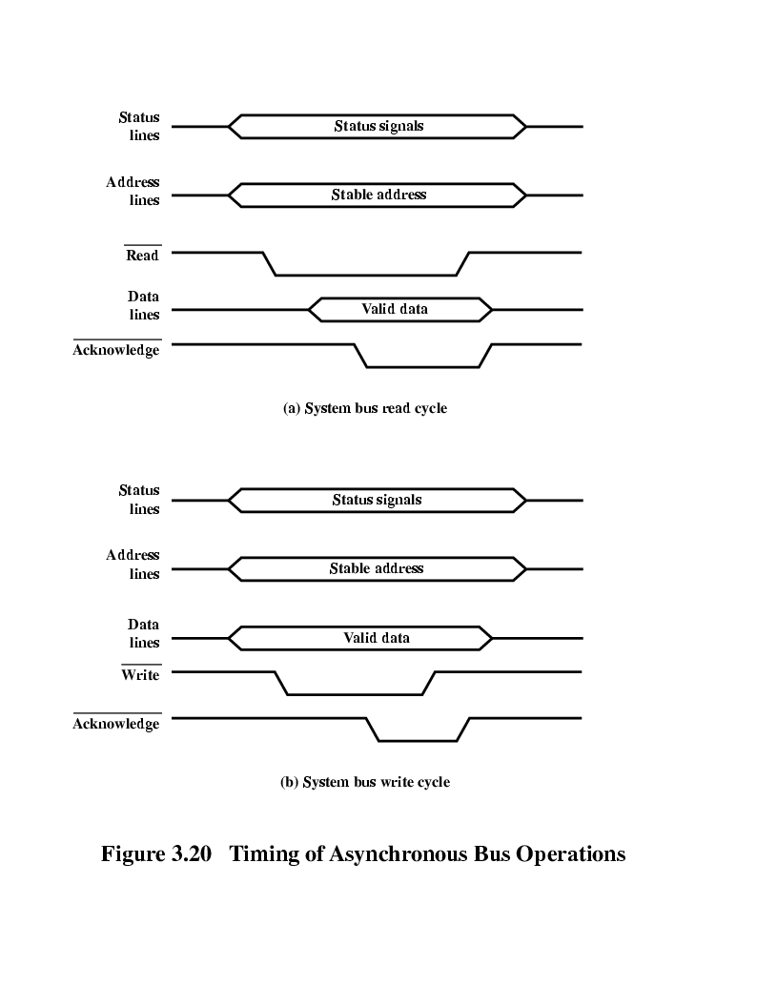
Asynchronous Timing – Read Diagram

Slide 28
Asynchronous Timing – Write Diagram

Slide 29
Inside The 8088/8086
Concepts important to the internal operation of 8088/8086
Pipelining
Registers

Slide 30
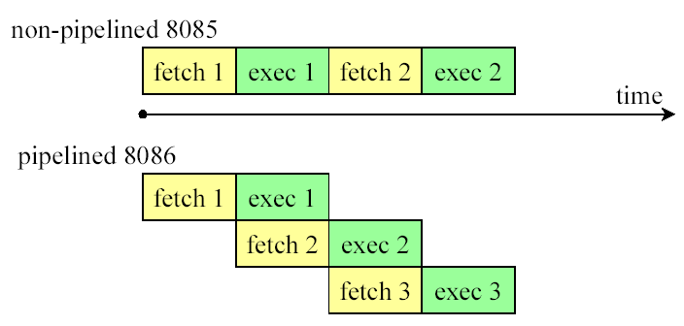
Inside The 8088/8086…pipelining
Pipelining
Two ways to make CPU process information faster:
Increase the working frequency – technology dependent
Change the internal architecture of the CPU
Pipelining is to allow CPU to fetch and execute at the same time

Slide 31
Inside The 8088/8086…pipelining
Intel implemented the concept of pipelining by splitting the internal structure of the 8088/8086 into two sections that works simultaneously:
Execution Unit (EU) – executes instructions previously fetched
Bus Interface Unit (BIU) – accesses memory and peripherals

Slide 32
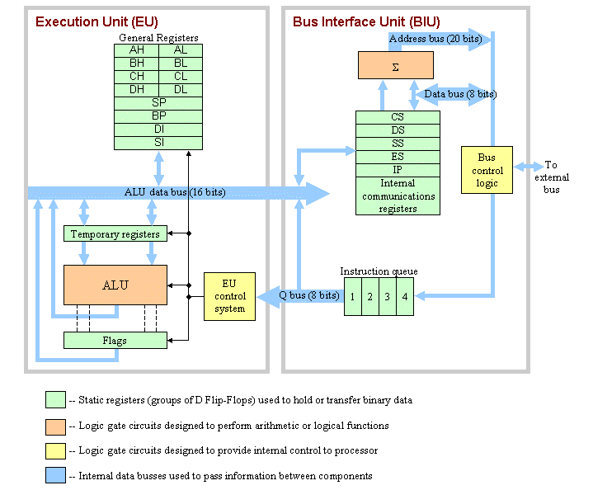
CPU Architecture of 8086/8088c

Slide 33
Registers

Slide 34
Registers:
Benefits of Registers.
Types of Registers.
General Purpose Registers.

Slide 35
CPU Architecture of 8086/8088c
8088 and 8086 are functionally identical (16-bit CPU) except that 8088 uses 8 data lines in its data bus while 8086 uses 16 data lines in its data bus.

Slide 36
CPU Architecture of 8086/8088c
The 8086/8088 microprocessor consists of four functional units.
Execution unit (EU): decodes and executes machine instructions.
Arithmetic and logic unit (ALU): performs math and logical operations on command by the EU.
Internal storage (sometime called registers): is used for internal data storage.
Bus interface unit (BIU): handles all communications with the I/O via system bus and maintains instruction queue.

Slide 37

In the World of Computer, Registers are no more like childhood notebooks… In which we used to note our school work.
Notes:
Some manufacturers assign the numbers to the registers according to their functionality and some according to the number value e.g. r0,r1, and/or AC, PC etc

Slide 38
Basic Computer Organization
REGISTERS
In the world of computer, registers are inside processor.

Slide 39
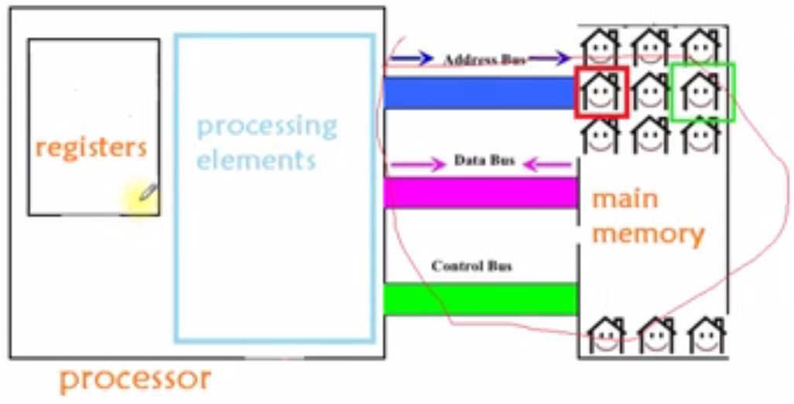
Registers in Assembly Language:

Slide 40
Basic Computer Organization
Why registers are compulsory???
We’ll understand this with the help of an example.

Slide 41
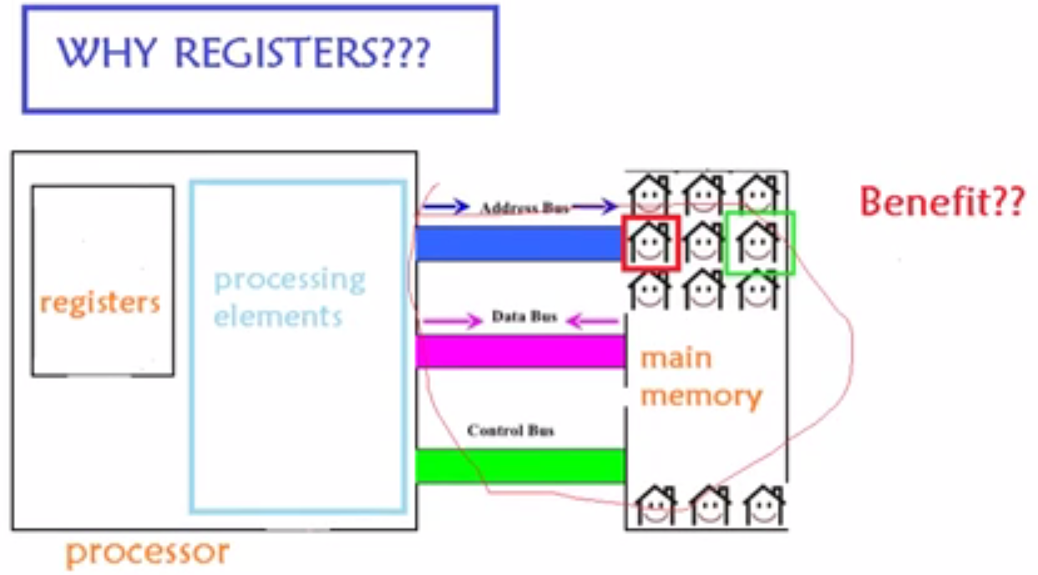
Houses:
Memory Allocations in RAM
Buses
Main Memory OR RAM
Suppose this is a processor

Slide 42
Basic Computer Organization
Why registers are compulsory???
We’ll understand this with the help of an example.
Example:
Suppose you have to calculate the sum of two numbers.
After calculation, store result in sum variable.

Slide 43
To calculate the sum,
We first declare a variable.
By this, memory for variable is allocated in the memory
After declaration of variables, if we take input from user,
Those inputs would appear in the corresponding memory locations.
Then declare another variable or second variable. Memory would be allocated for this variable too.

Slide 44
Basic Computer Organization
Now we have to send both the numbers (values of variables) to processor.
Only then processor can do some operation on those numbers.

Slide 45
Communication via Buses
First message would be sent via Control Bus if we want to read a number.
At the same time, processor would send the address via Address Bus to tell that from this address of memory, send me the number.
Then Memory would place the number in the Data Bus.

Slide 46
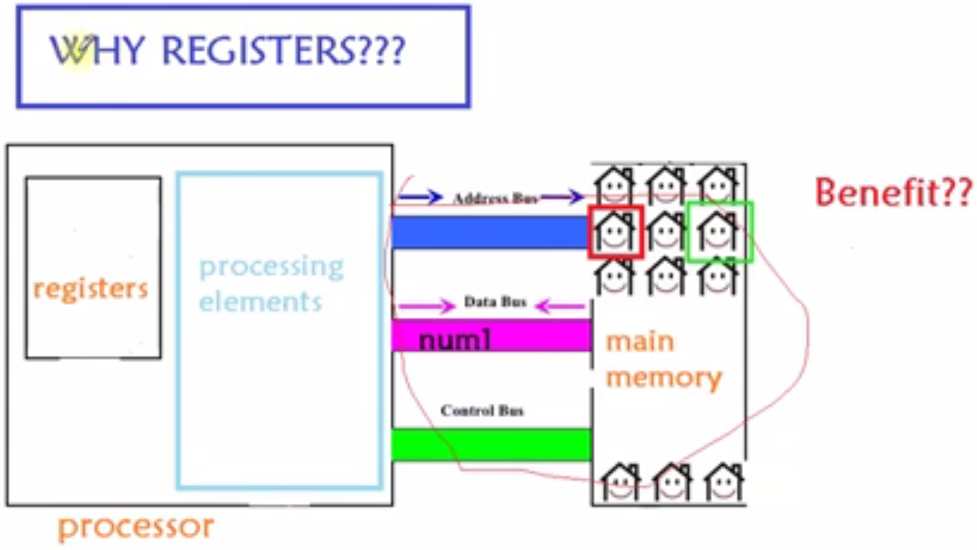
Memory has sent the num1:
Now processor would definitely need the second number too for the addition of two numbers.
Memory has sent the first number

Slide 47
The following same procedure would repeat to get the second number from memory
First message would be sent via Control Bus if we want to read a second number.
At the same time, processor would send the address via Address Bus to tell that from this address of memory, send me the number.
Then Memory would place the second number in the Data Bus.
What would happen to the first number which was already present in the Data Bus???
That first number would be wasted. As Data Bus now would have the second number.
So, that was the issue. When Data Bus would get second number, then the first number would get vanished.
To calculate the sum of two numbers, processor would need two numbers at the same time.
To solve this problems, registers were developed.

Slide 48
Registers
Now when RAM had given the first number, we have stored this first number into the register.
Then the processor asks the memory for the second number, now the second number is in the Data Bus.
Now processor would take first number from register and second number from Data Bus, Add these two numbers and store the result into new memory location.
That was the benefit of the register!!!

Slide 49
What is Operand?
There are many memory allocations in the RAM. Means a lot of data in the RAM.
The type of Data on which processor has to do processing is known as Operand.
e.g. num1 and num2 are two operands.
So, Register is basically a temporary place to store data on temporary basis. It is very close to CPU. It is inside the processor, that’s why processing would get Faster.

Slide 50
Why processing is faster in registers?
If processor has to take data from RAM, then how many steps processor has to perform?
Processor send message via Control Bus, send address via Address to RAM, and then processor waits for the RAM to send data via Data Bus.
To take data from registers:
Processor does not need to send message via Control Bus, does not need to send address via Address Bus, and does not have to wait to have data on Data Bus.
It is time saving for processor to get data directly from registers. So, processing gets faster because of registers.

Slide 51
Inside The 8088/8086…registers
Types of Registers
To store information temporarily
AX
16-bit register
AH
8-bit reg.
AL
8-bit reg.
Category Bits Register Names
General 16 AX, BX, CX, DX
8 AH, AL, BH, BL, CH, CL, DH, DL
Pointer 16 SP (stack pointer), BP (base pointer)
Index 16 SI (source index), DI (destination index)
Segment 16 CS (code segment), DS (data segment)
SS (stack segment), ES (extra segment)
Instruction 16 IP (instruction pointer)
Flag 16 FR (flag register)
Special Purpose Registers
x = size
General Purpose registers are also known as Multi Purpose Registers.

Slide 52
Anatomy of a Register
Extended Register
Word Register
Bits 16-31
Bits 8-15
Bits 0-7
High Byte
Low Byte
Register
Register
Notes:
Page 52
In today’s 32-bit architecture, each register has 32 bits that can be used. However, some registers can be accessed as a single byte, and all registers can be accessed as a 16-bit value, or a 32-bit value. This is further explained on the next slide.

Slide 53
General Registers
32 bit Registers |  | 16 bit Registers |  | 8 bit Registers
EAX | EBP | AX | BP | AH | AL
EBX | ESI | BX | SI | BH | BL
ECX | EDI | CX | DI | CH | CL
EDX | ESP | DX | SP | DH | DL
Bits 16-31
Bits 8-15
Bits 0-7
Notes:
Page 53
The 32-bit general-purpose registers EAX, EBX, ECX, EDX, ESI, EDI, EBP, and ESP are provided for holding the following items: operands for logical and arithmetic operations, operands for address calculations, and memory pointers.
Registers can be broken down into 16 and 8 bit registers.
We will use the notation “(E)AX” to refer to any of AL, AH, AX, or EAX.
Each of the lower two bytes of the EAX, EBX, ECX, and EDX registers can be referenced by the names AH, BH, CH, and DH (high bytes) and AL, BL, CL, and DL (low bytes).
The lower two bytes of the other registers – EBP, ESI, EDI, and ESP – can not be referenced.
Many instructions assign specific registers to hold operands. For example, string instructions use the contents of the ECX, ESI, and EDI registers as operands (details will be given later).

Slide 54
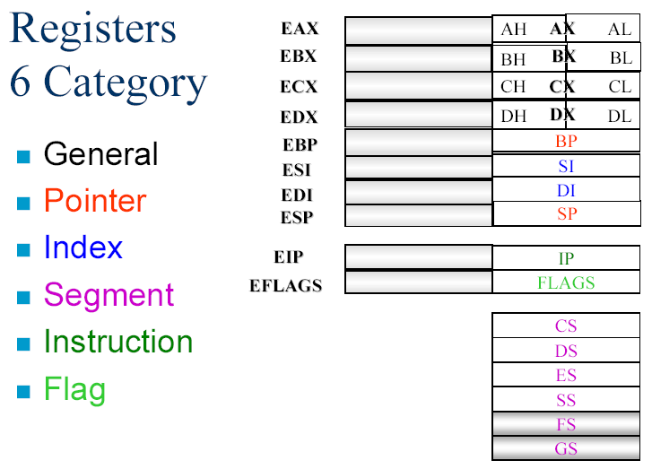

Slide 55
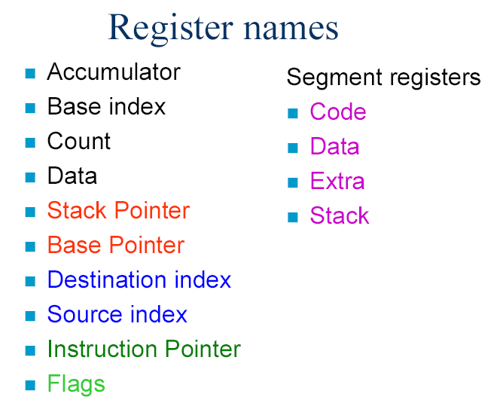
OR Destination

Slide 56
CPU word size/ CPU width: It means how many no. of bits that can be processed by CPU. Size of Accumulator decides the size of CPU word size.

Slide 57
Common thing in General Purpose Registers: All the General Purpose Registers can be used to take inputs, to display outputs and to store intermediate results. We store data in General Purpose Registers with the help of instructions.

Slide 58
1. AX: Accumulator Register involves in each operation: It involves in taking input, output, and even to hold intermediate results. In other words we can say that Accumulator is used to perform Mathematical, Arithmetic and Logical operations. Also if we want to store address of other memory location, for this purpose again accumulator can be used.

Slide 59
2. BX: Base Register: Suppose you have created an Array “A” in the memory. Then name of the array i.e. A would represent the starting address of the array. Starting address is also known as Base Address. Base Address is used to store the starting address of any Data Structure.
0
1
2
3
4
5
A
Base address = starting address

Slide 60
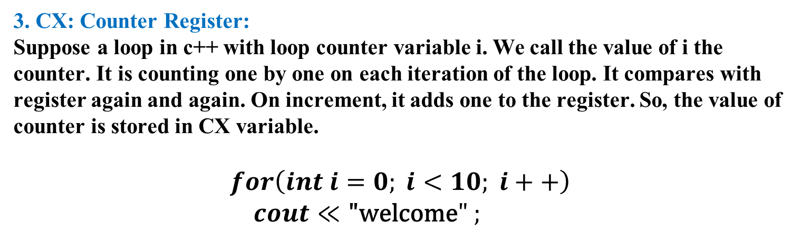
3. CX: Counter Register: Suppose a loop in c++ with loop counter variable i. We call the value of i the counter. It is counting one by one on each iteration of the loop. It compares with register again and again. On increment, it adds one to the register. So, the value of counter is stored in CX variable. $$for\left(int i=0; i<10; i++\right) \\ cout≪\text{"}\text{welcome}" ;$$

Slide 61
4. DX: Destination Register: It is basically used for destinations. We can store the final output of the operations in it. Answer of num1*num2 is in 32 bits. Size of Accumulator was 16 bits. So, this answer cannot be stored in Accumulator. If we would try to save 32 bits answer in Accumulator, only 16 bits would be saved in Accumulator. What would happen to the remaining 16 bits: Two options: Only store 16 bits and discard the remaining 16 bits. If we don’t want to discard our data, then we can store 16 bits in AX and store the remaining 16 bits in the DX. So, our data would not get discard.

